Slide 1

Team Ländlepest
Aisha, Alex, Alik, Braian
TU Vienna – Hackathon „Watt‘s Up“ 2025

Slide 2

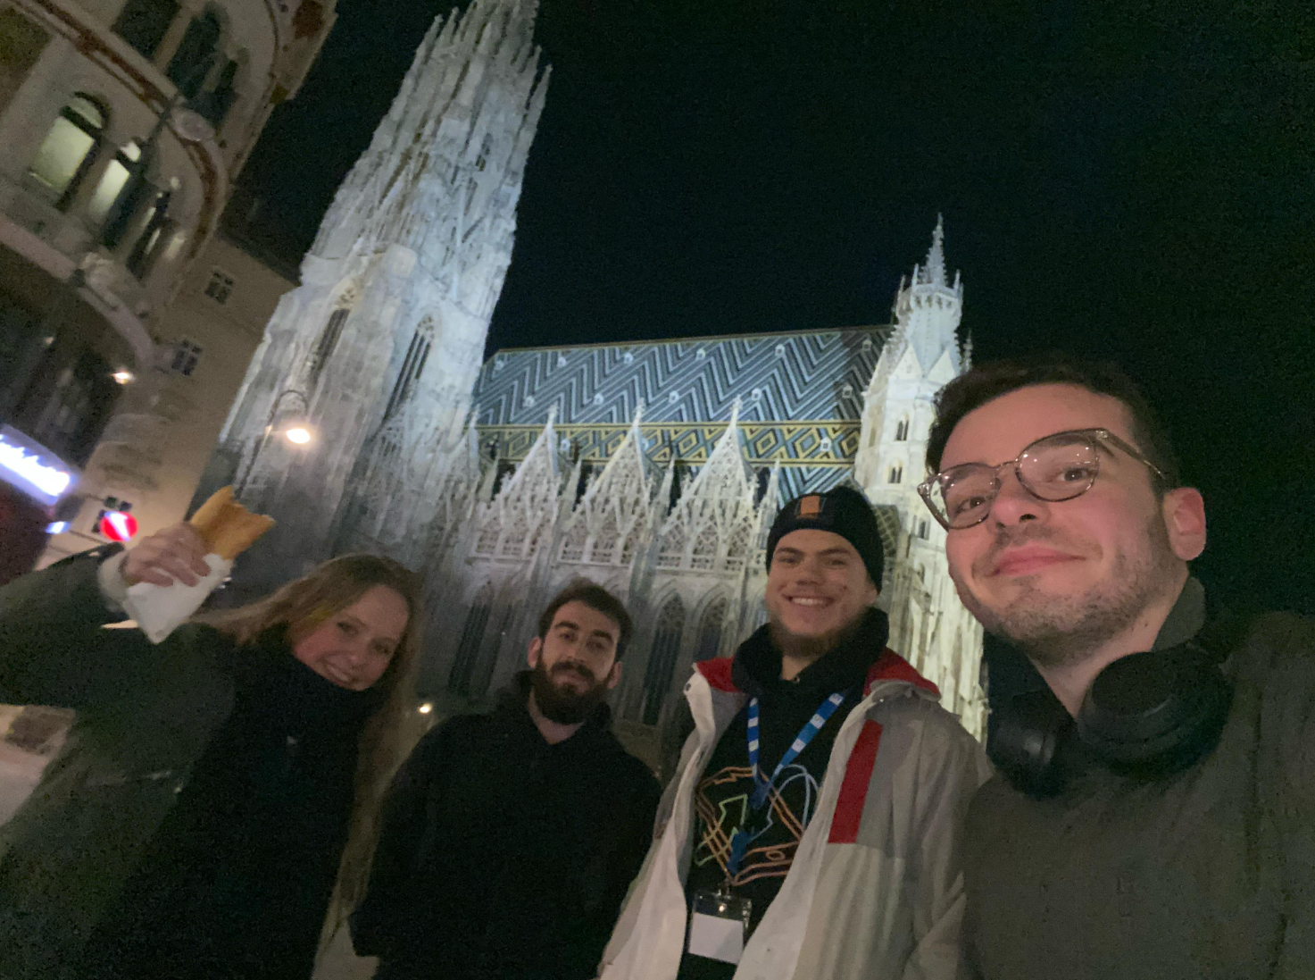


Our Team: Aisha and Braian from “Ländle” & Alex and Alik from Budapest

Slide 3

Objective
Generate a synthetic dataset that mirrors the statistical patterns of real energy usage data of 8760 hours (a full consecutive year)
Ensure individual user profiles remain unidentifiable in the synthetic dataset
Validate the trustworthiness of the synthetic data through rigorous testing to provide evidence that the info on single profile levels cannot be inferred from the real data
2025 Hackathon – TU Vienna

Slide 4

Approach #1
Compress data
Desensitize personal info
Analyze patterns
Decompress data
2025 Hackathon – TU Vienna

Slide 5
Approach #2
Predict future consumption
Generate Synthetic data
Validate accuracy
2025 Hackathon – TU Vienna

Slide 6


implementation

Slide 7
Resources
For this project, following applications were used:
Google Colab
Jupyterhub
Github
Perplexity
…

Slide 8
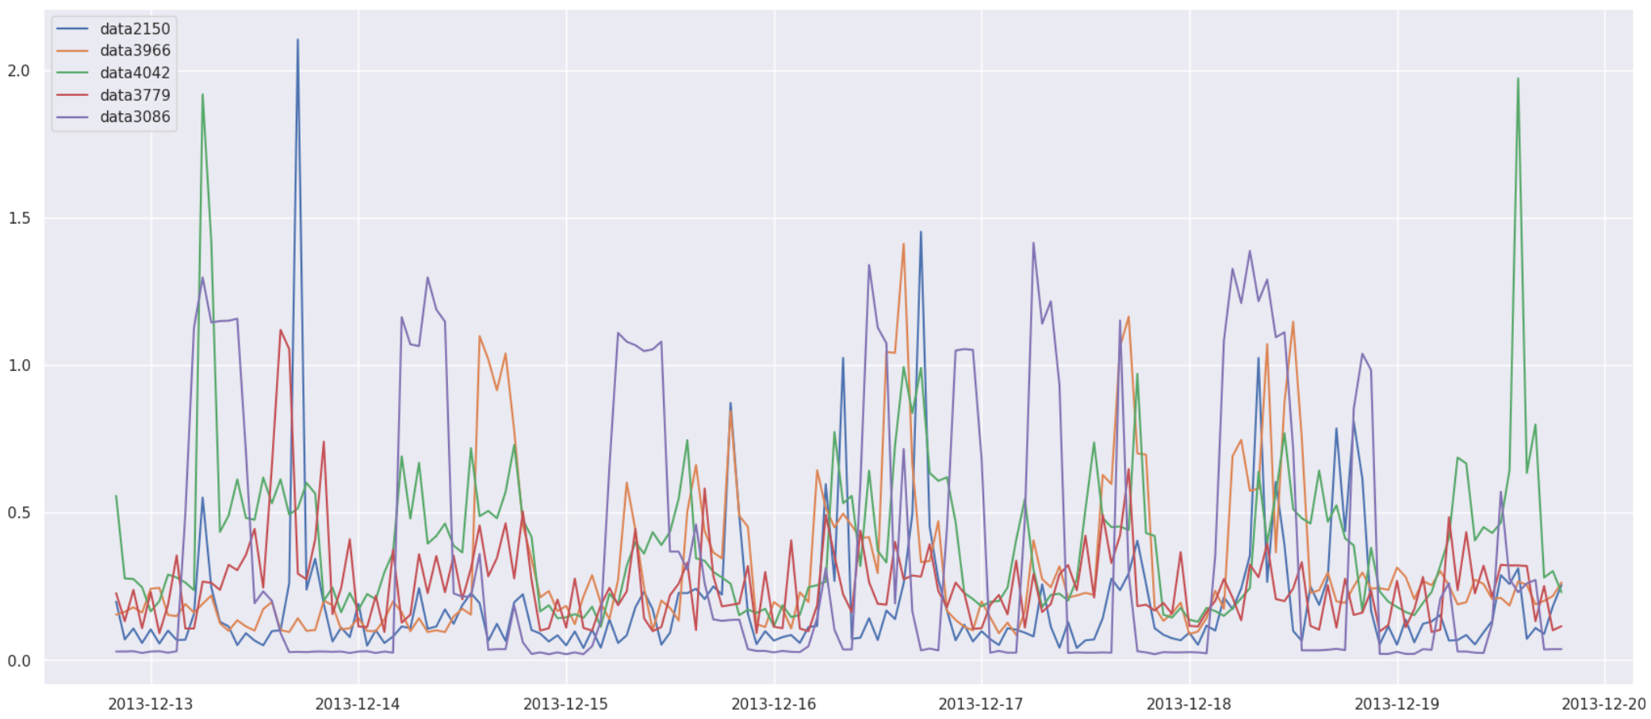
Sample Data – 5 random profiles in a week
ENERGY CONSUMPTION
2025 Hackathon – TU Vienna
TIME

Slide 9

Different approaches, same goal
Privacy-Preserving Compression
Predictive Accuracy with Synthetic Data
Focuses on reducing data size while trying to ensure personal information is desensitized.
Through the regeneration of the decompressed data after desensitization, we create synthetic data
Emphasizes testing the accuracy of synthetic data by comparing predictions to real data
Synthetic data is generated from the use of future predictions through ML and randomization
2025 Hackathon – TU Vienna

Slide 10


Results

Slide 12
Answering the coaches

Slide 13
Can we, in fact, prevent inferring real single profile data from synthetic data?
2025 Hackathon – TU Vienna

Slide 14
How could one determine if synthetic data is “trustworthy”?

Slide 15

Thank you
Any Questions?

